Slide 1

PARSING EQUATIONS
CA2 – Evaluating & Sorting Assignment Statements
Lim Zhen Yang 2214506
DAAA / FT / 2B / O4
Group 5

Slide 2

01.
Main Functionality

Slide 3
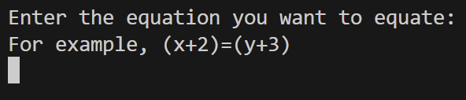
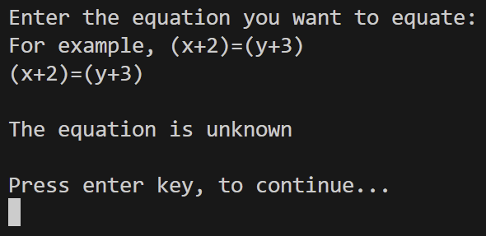
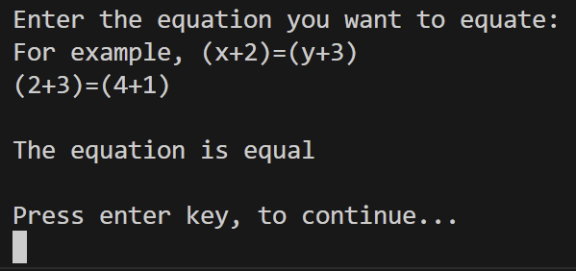
Individual Option 1 | Equating Equations
The user can input an equation which is defined as two expressions separated by an ‘=‘ sign
When using variables that have not been defined, the equality of the equation is unknown

Slide 4
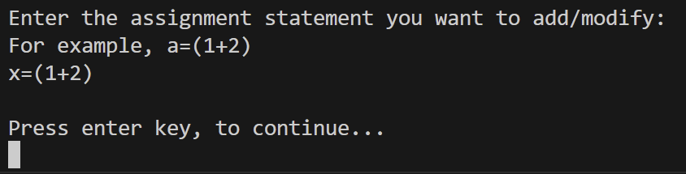
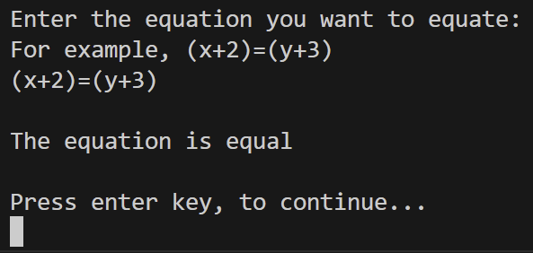

Individual Option 1 | Equating Equations
You can use previously defined variables in the equations
Now the equation can be equated

Slide 5
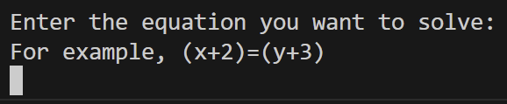
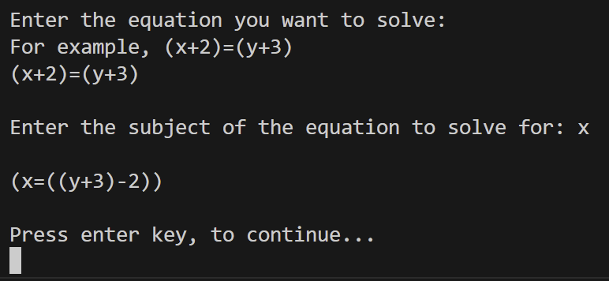
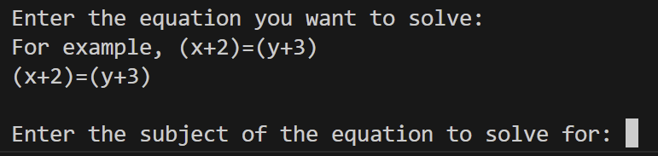
Individual Option 2 | Subject Of Equation
The user can input an equation which is defined as two expressions separated by an ‘=‘ sign
‘x’ is isolated on the left side
User can specifiy the variable wanted as the subject

Slide 6
02.
Usefulness

Slide 7

Why it is useful
Calculate the equality of a combination of multiple variables
Can help users algebraically manipulate equations

Slide 8
Thank You

